Slide 1
Best Practices in Phylogenetic Comparative Analyses
EQGW 2025

Slide 2
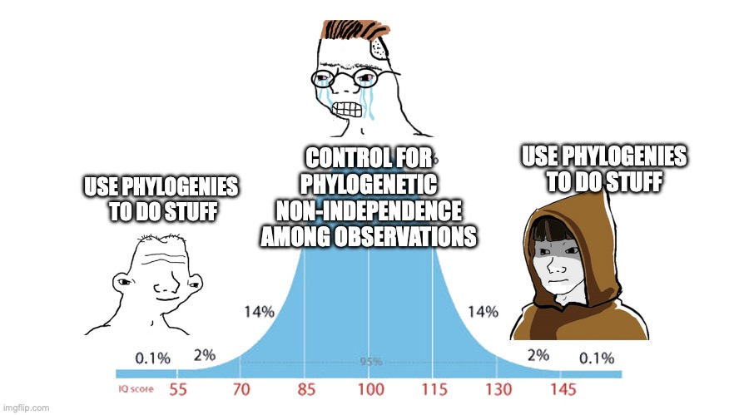
Phylogenetic comparative methods

Slide 3
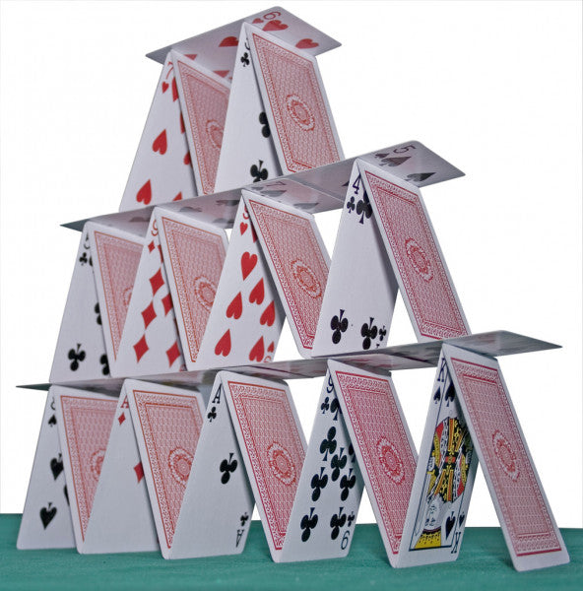
interpretation
Models
“Estimated data”
(phylogenies)
Data

Slide 4
interpretation
Models
inadequacy
“Estimated data”
(phylogenies)
error/
inadequacy
error
Data

Slide 5
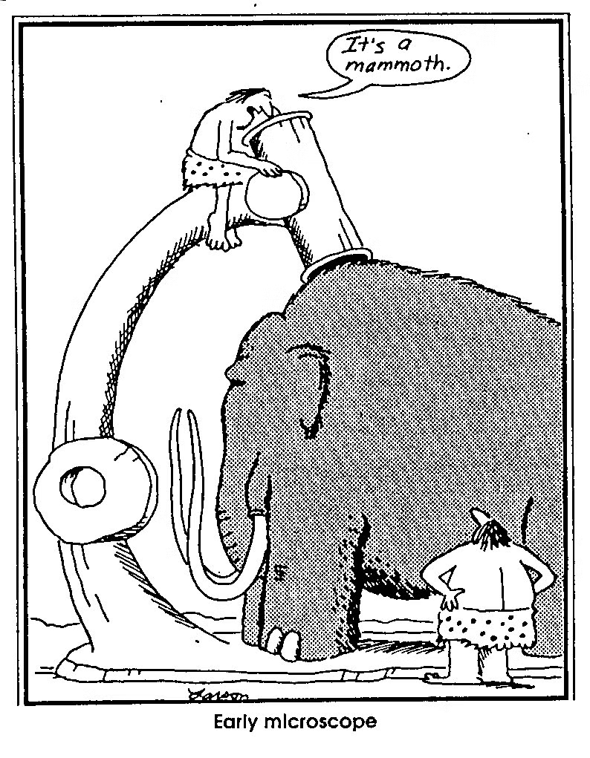
Measurement error
Measurement errors are not perfect (and sometimes we screw up)

Slide 6
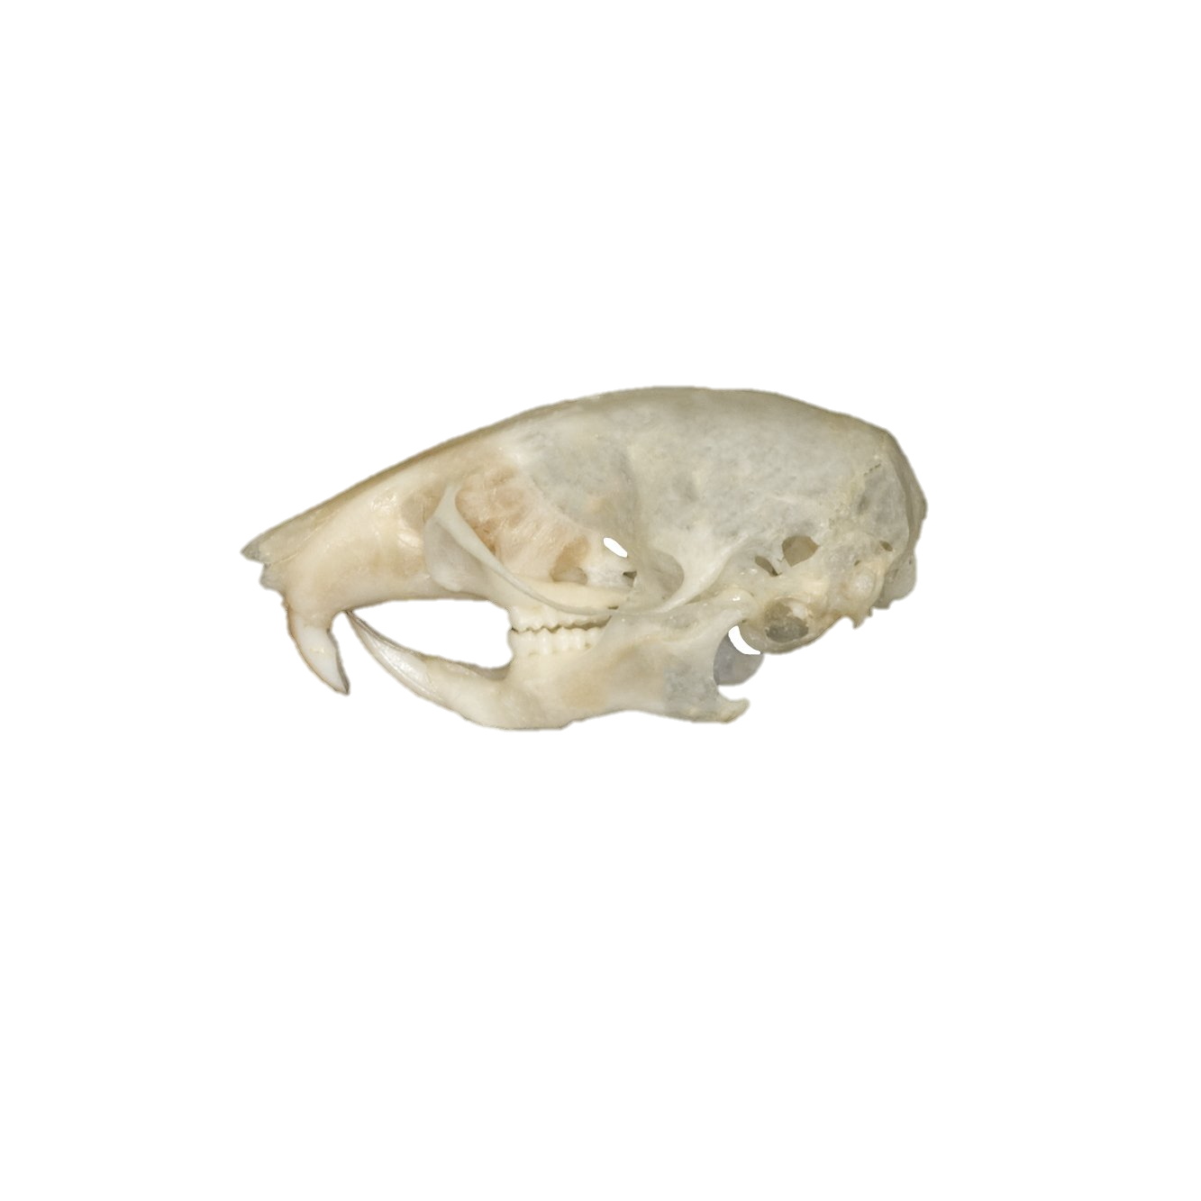
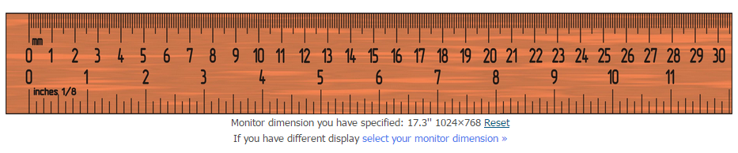
Measurement error
Multiple sources:
Equipment error/imprecision

Slide 7

Measurement error
Multiple sources:
Equipment error/imprecision
Interobserver error

Slide 8
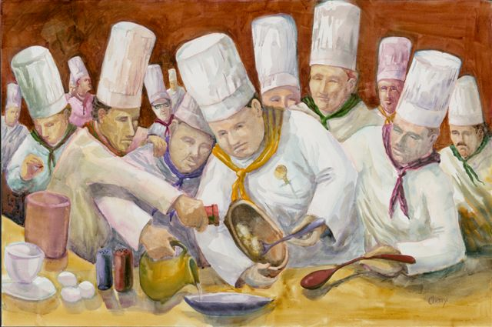
Measurement error
Multiple sources:
Equipment error/imprecision
Interobserver error
Interobserver error

Slide 9

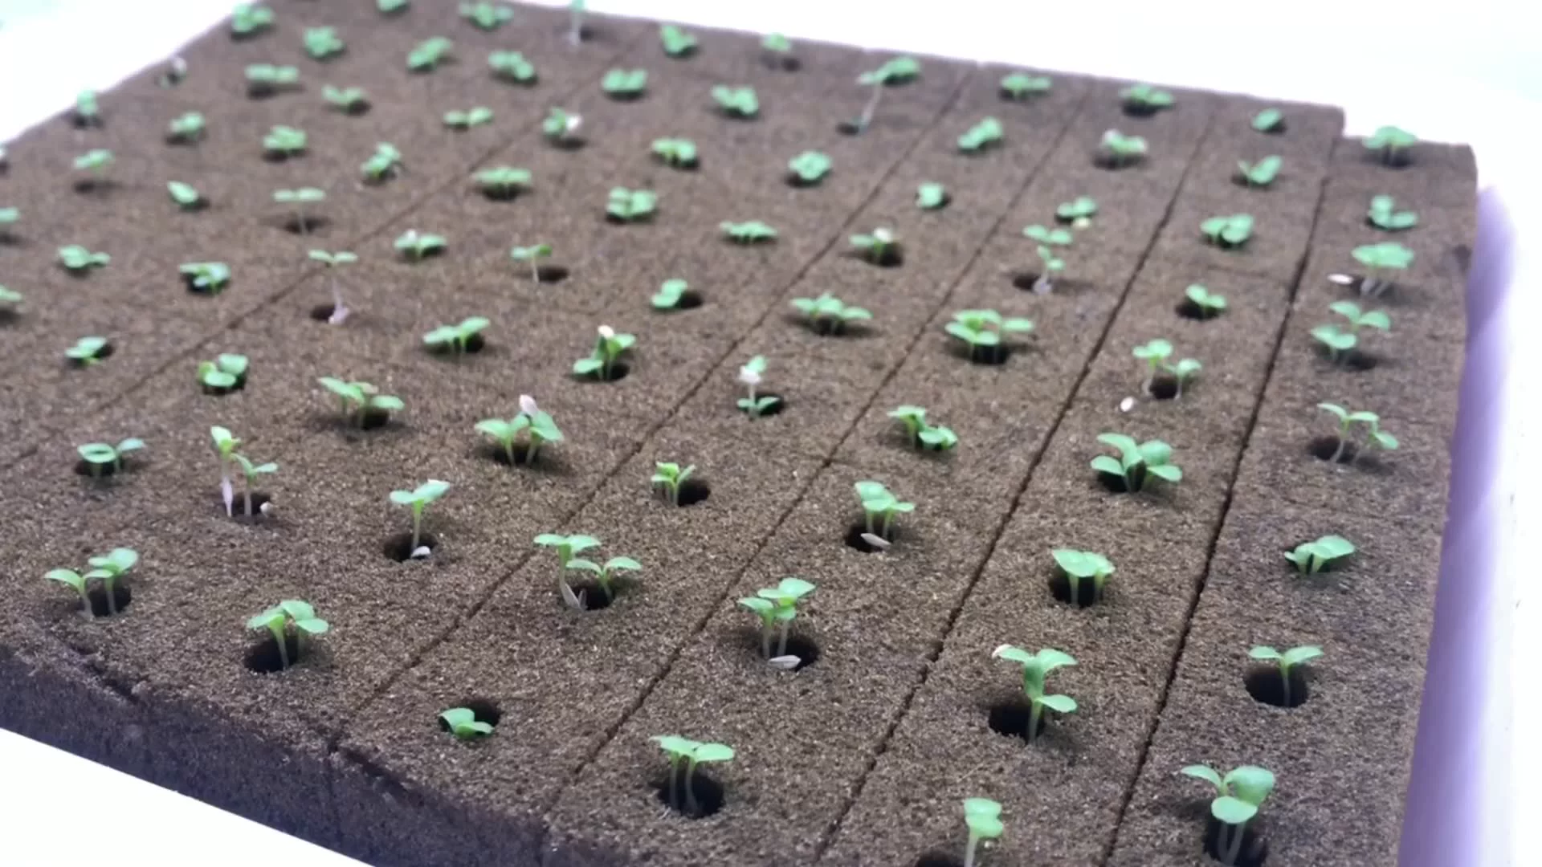
Measurement error
Multiple sources:
Equipment error/imprecision
Interobserver error
Interobserver error
Intraindividual- behavior/physiology
Blocks – treatments
…
etc
Why would it matter in PCM?

Slide 10
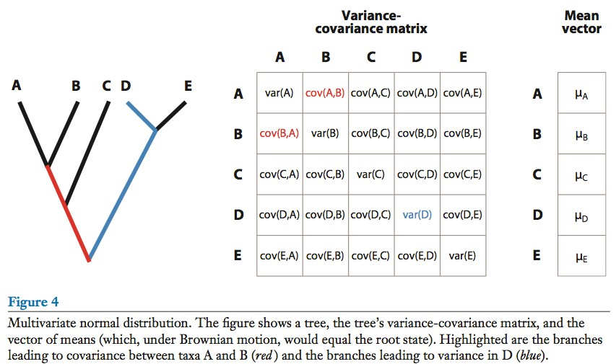
If we have error, this is imprecise
O’Meara 2012

Slide 11
+error
+error
+error
+error
+error
Does in matter in reality?
O’Meara 2012

Slide 12
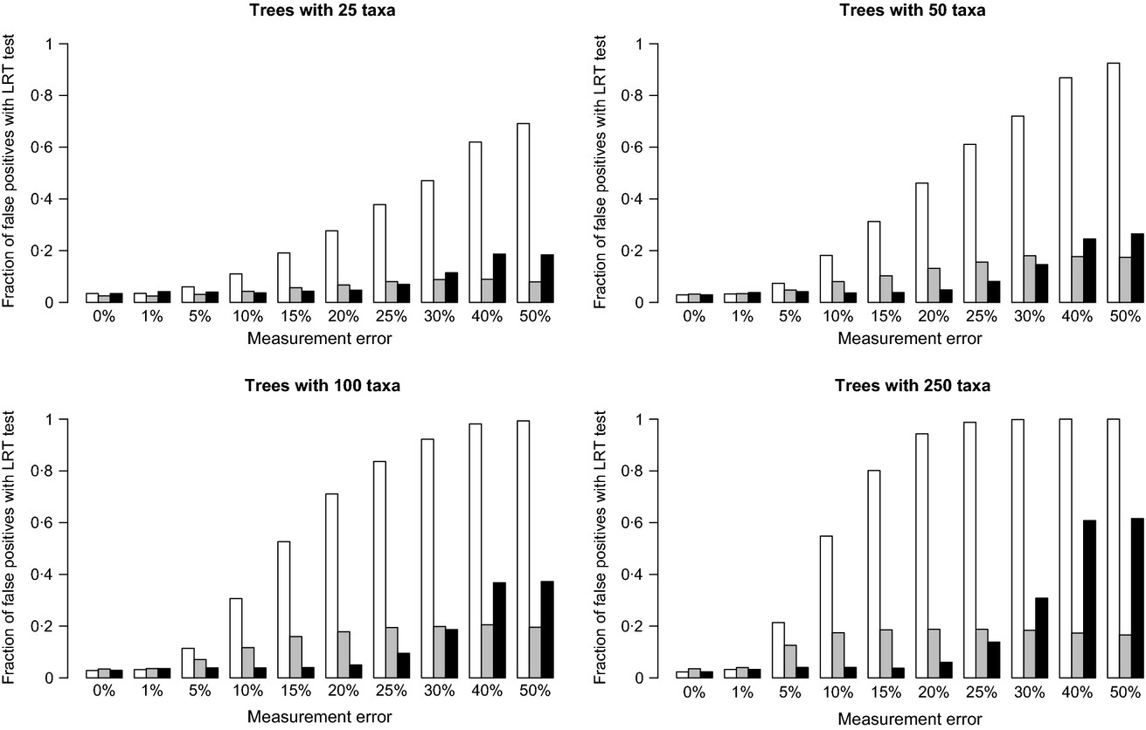
White- ME ignored; Gray- ME estimated; Black- ME known
Silvestro et al 2015

Slide 13
Lessons
Always account for measurement error

Slide 14
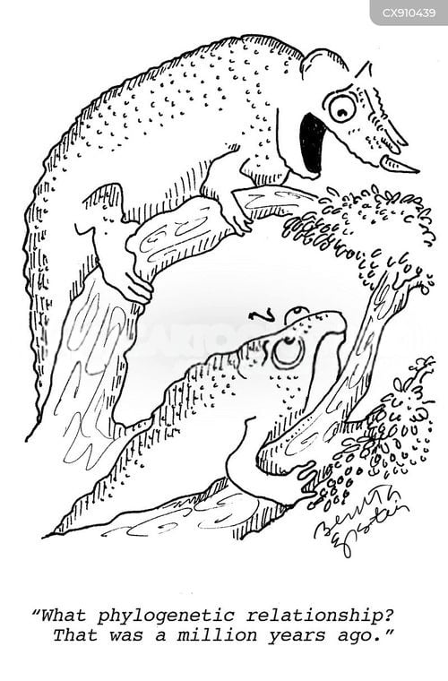
Phylogenetic uncertainty
Phylogenies are estimated, and therefore have errors and uncertainties

Slide 15
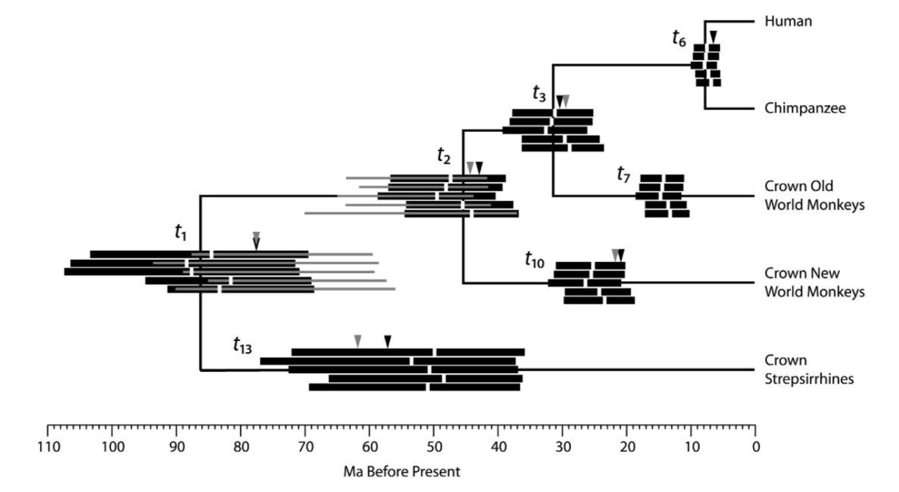
Phylogenetic uncertainty
Wilkinson et al. 2011

Slide 16
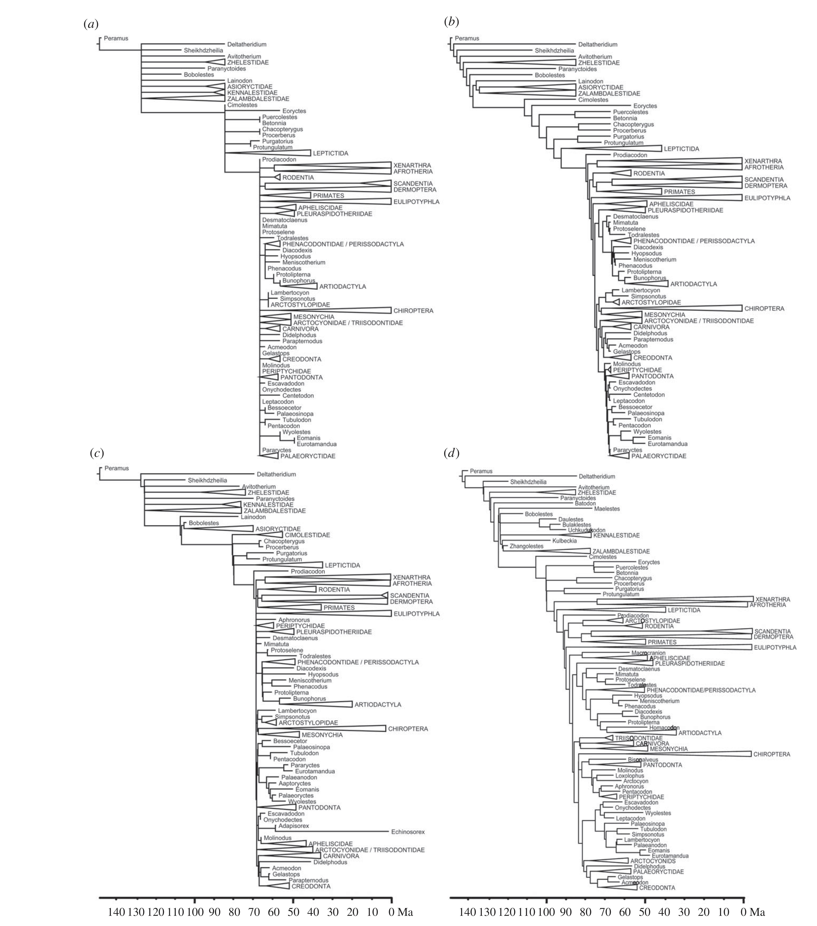
Minimum age dating
Equal branch sharing
Fossilized birth-death
cal3
Halliday & Goswami 2016

Slide 17
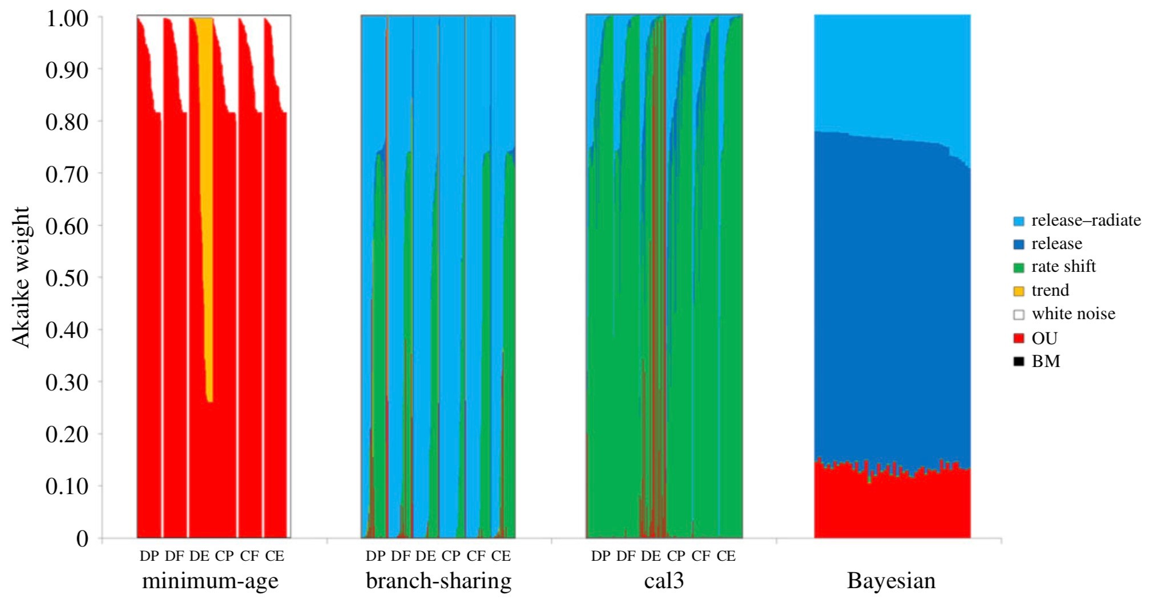
Halliday & Goswami 2016

Slide 18
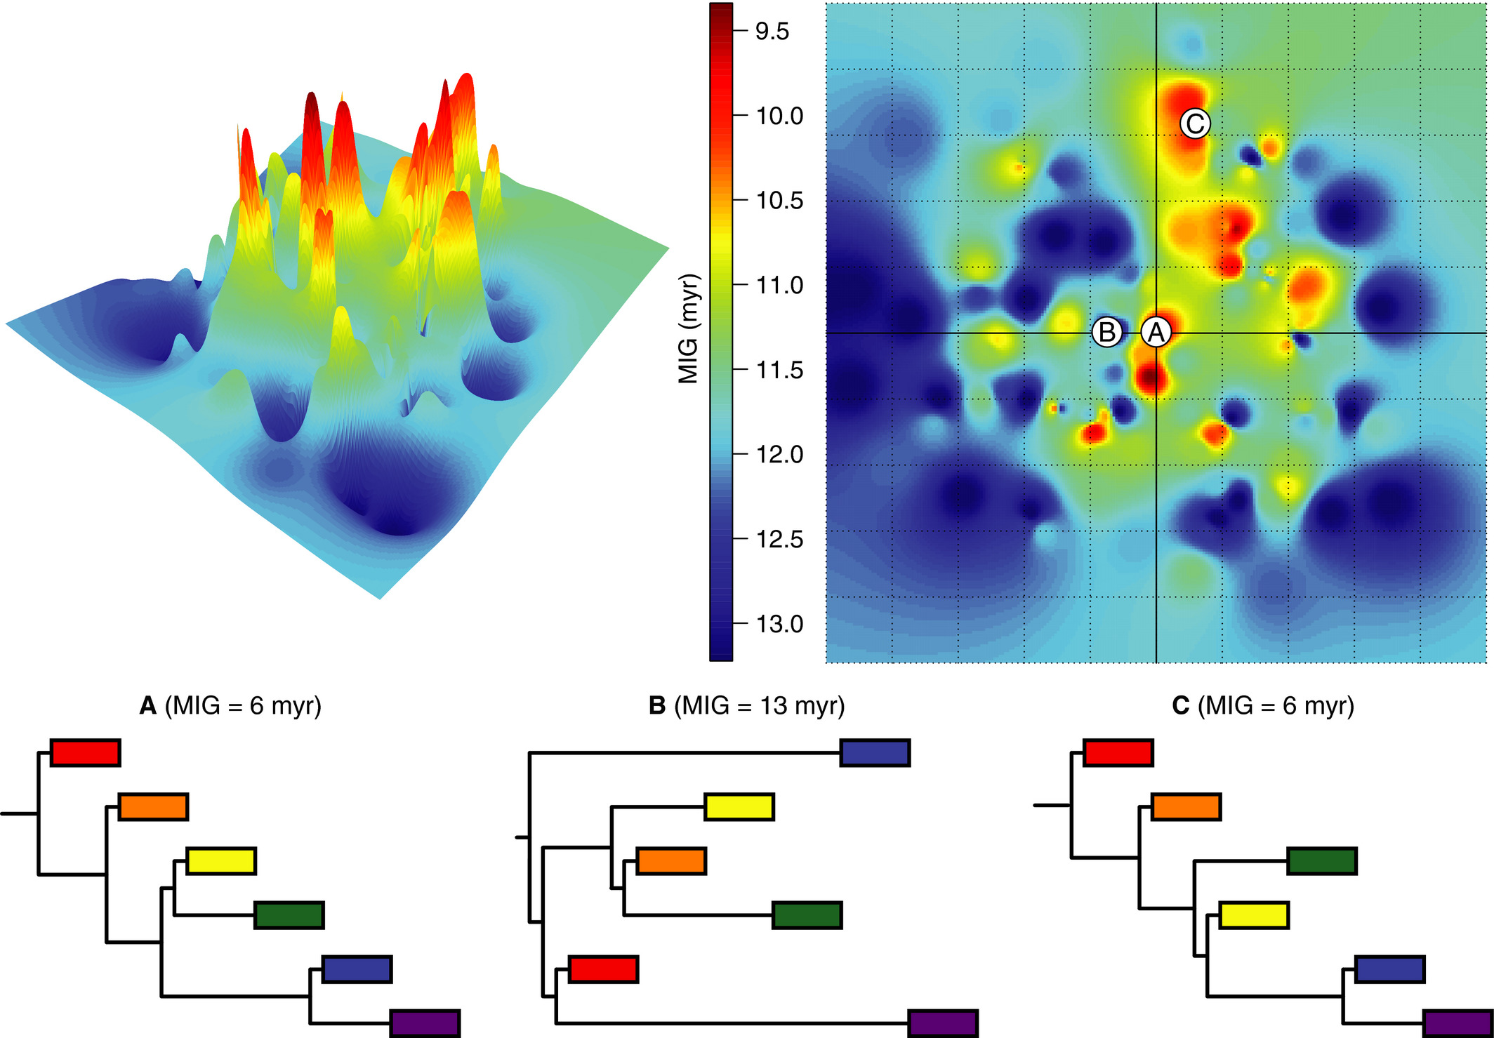
Wright & Loyd, 2020

Slide 19
Data
Data
Data
Method
Method
Method
Results
Results
Results

Slide 20
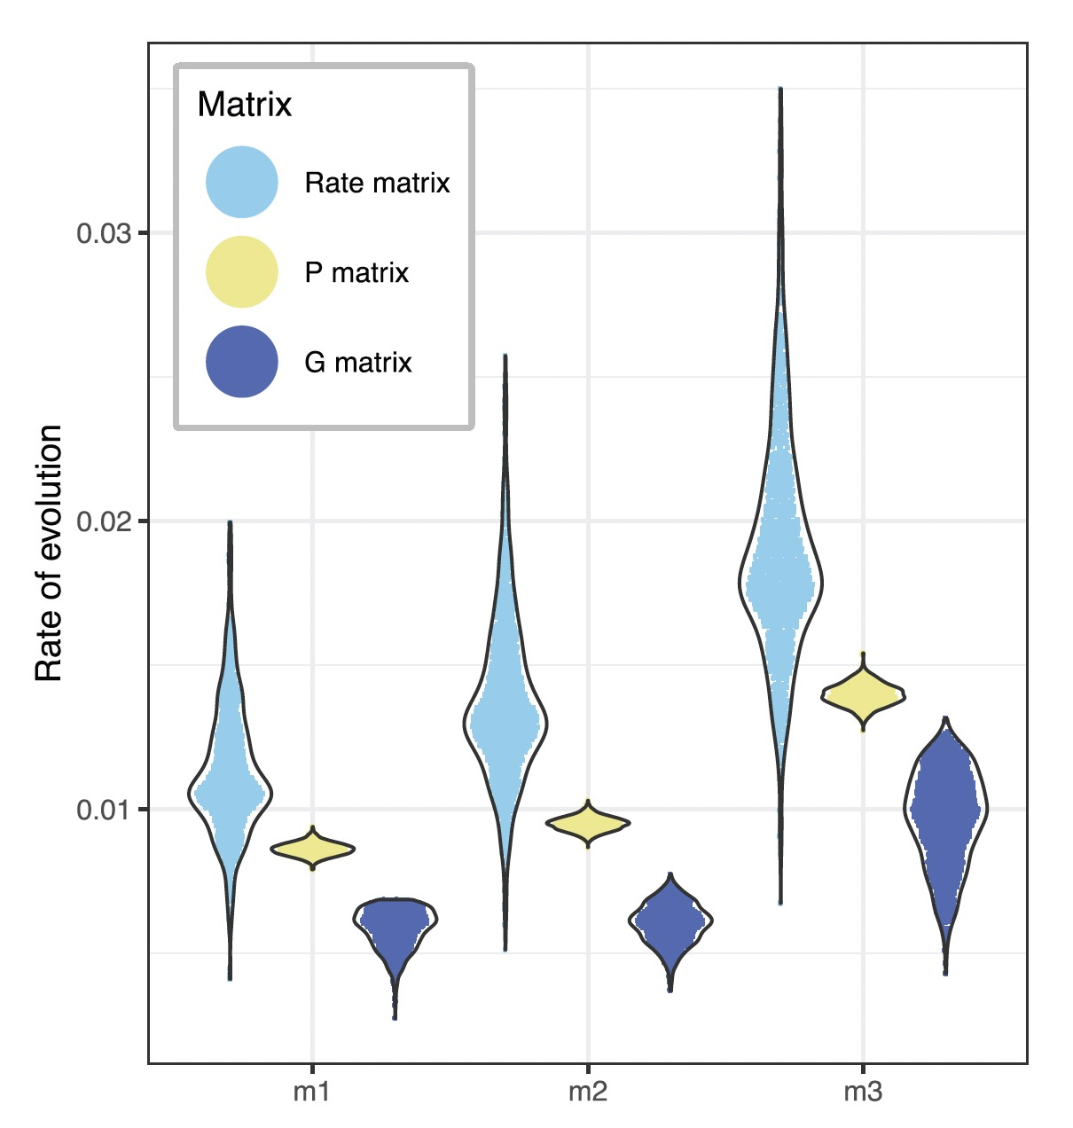
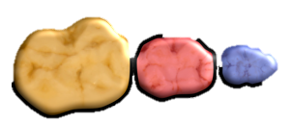
Mongle et al., 2022

Slide 21
Lessons
Always account for measurement error
Always account for phylogenetic uncertainty

Slide 22
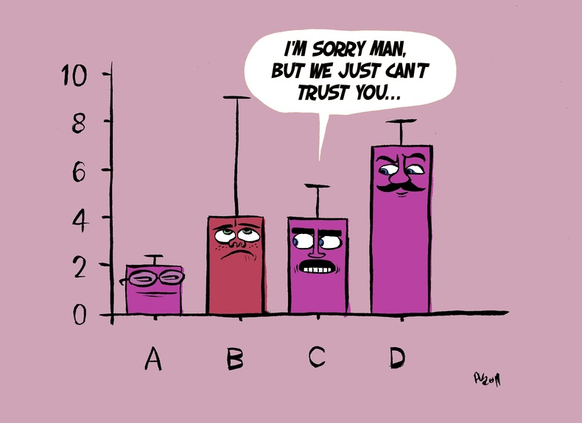
Parameter Estimation error
Model parameters are estimated with error

Slide 23
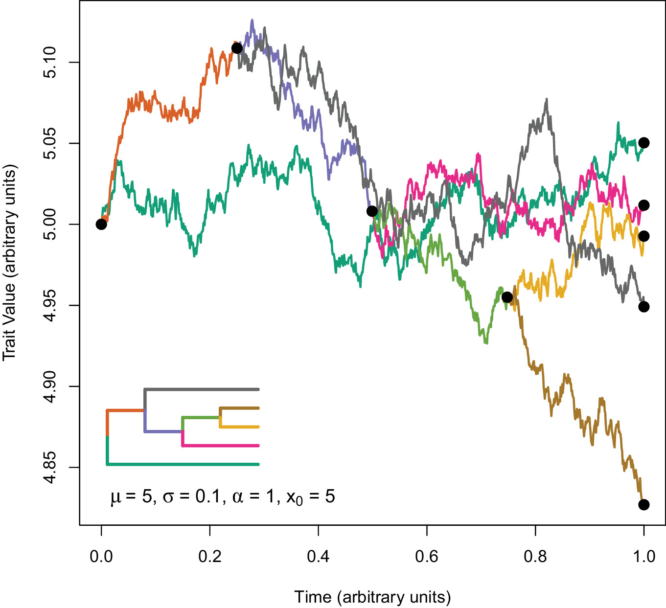

Parameter estimation
OU: optimum μ
Ancestral state y₀

Slide 24
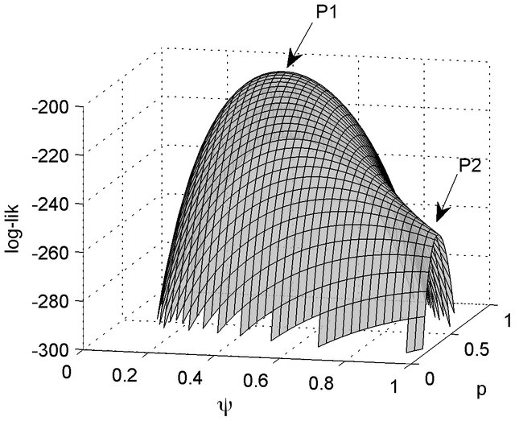
Parameter estimation is an optimization procedure on a likelihood surface

Slide 25
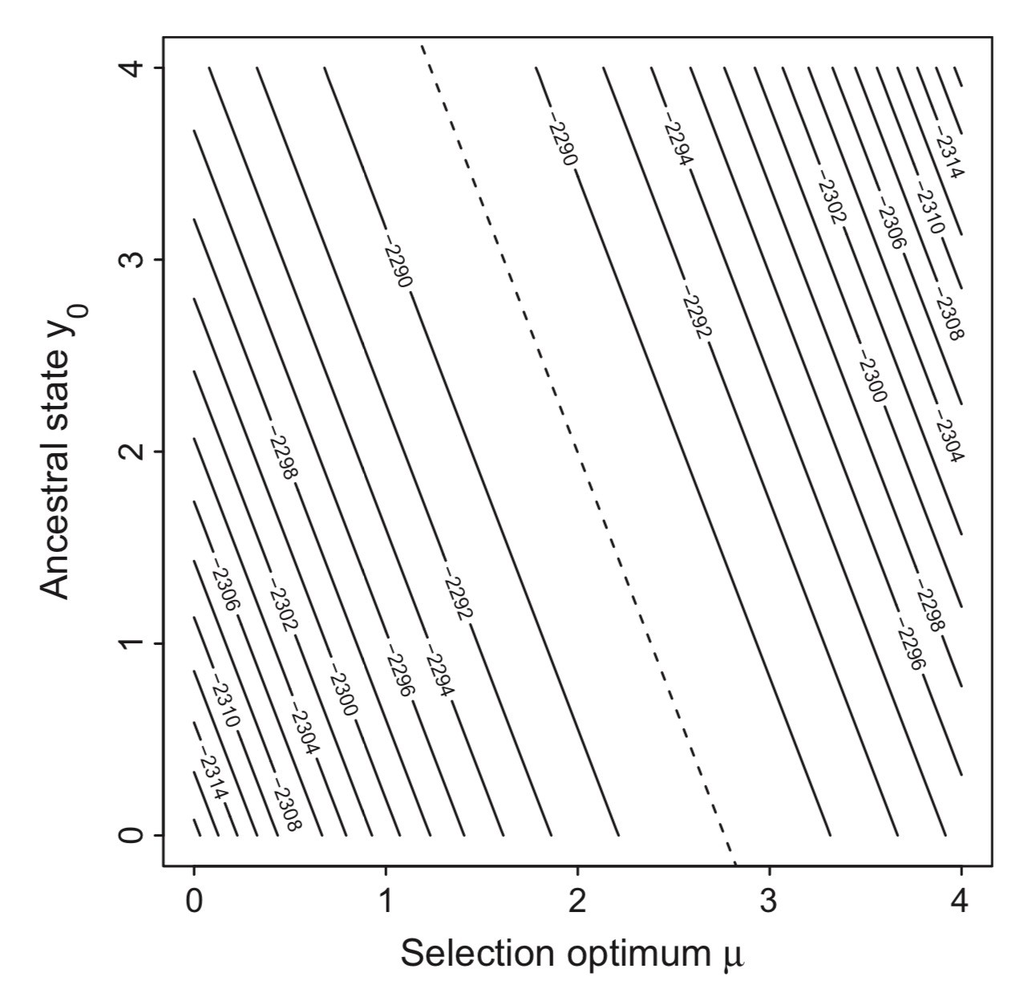
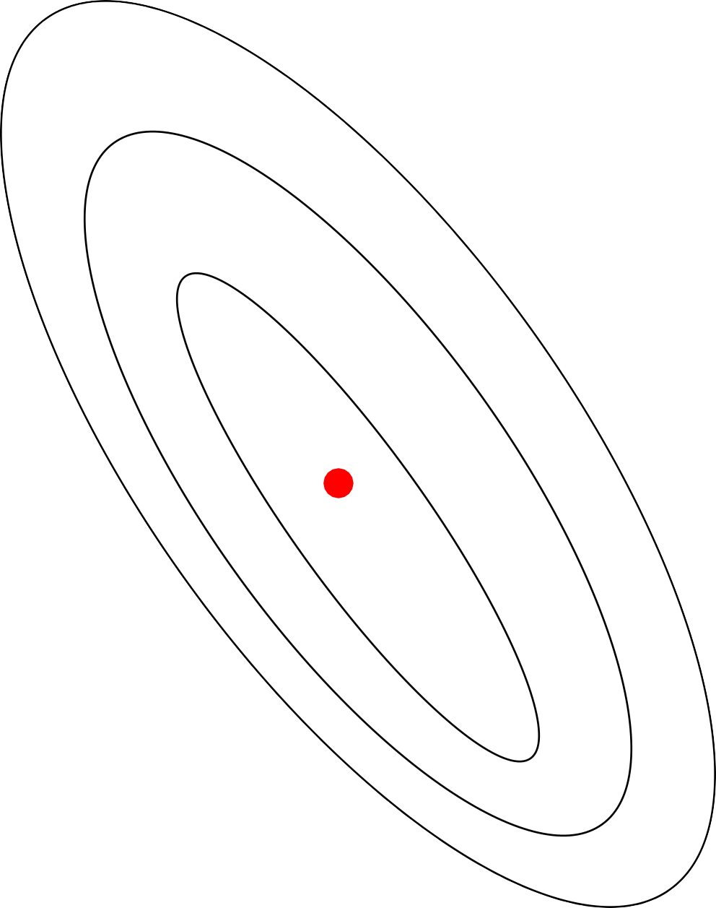
Parameter estimation is an optimization procedure on a likelihood surface

Slide 26
Sub-optimal likelihoods might also be considered “good enough”, specifically 2 log-lik units away from the peak
Parameter estimation is an optimization procedure on a likelihood surface

Slide 27
Sub-optimal likelihoods might also be considered “good enough”, specifically 2 log-lik units away from the peak
Parameter estimation is an optimization procedure on a likelihood surface

Slide 28
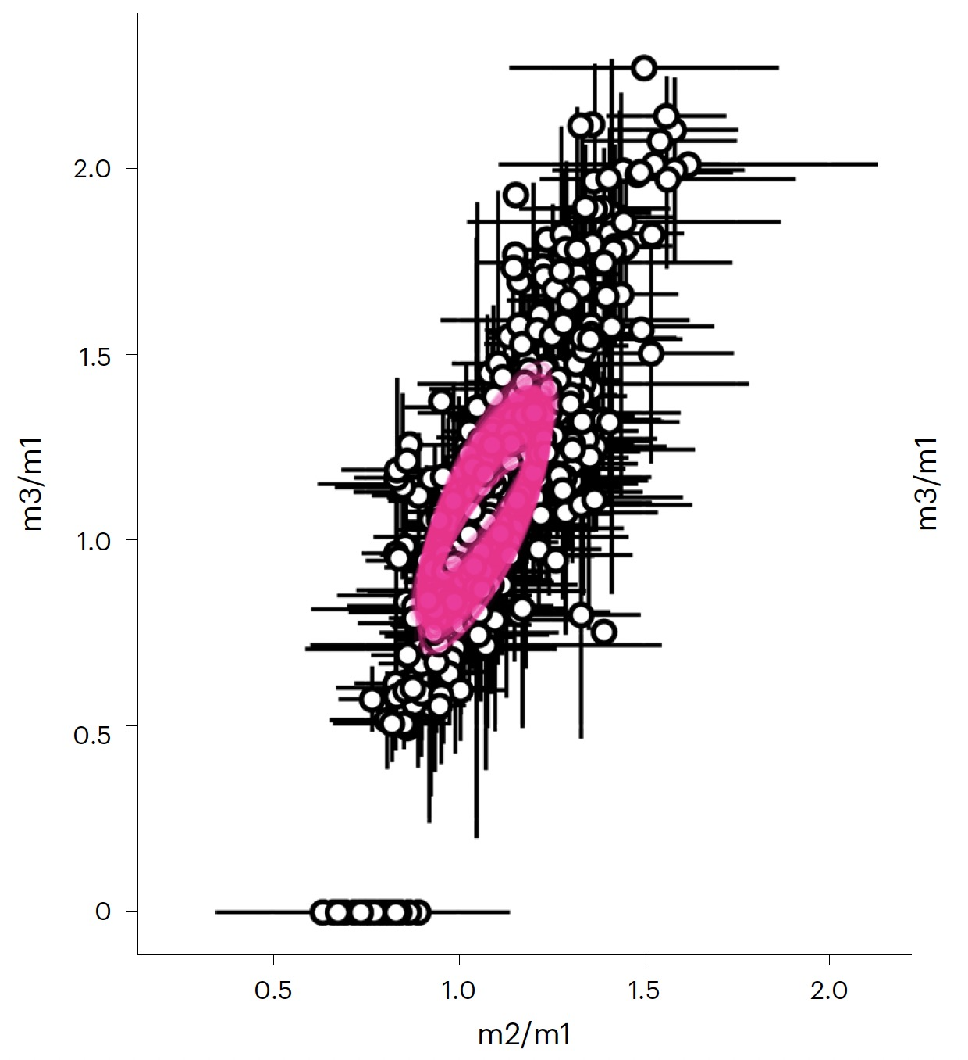
Rate matrix error
Machado et al. 2023

Slide 29
Lessons
Always account for measurement error
Always account for phylogenetic uncertainty
Always account for parameter estimation error

Slide 30
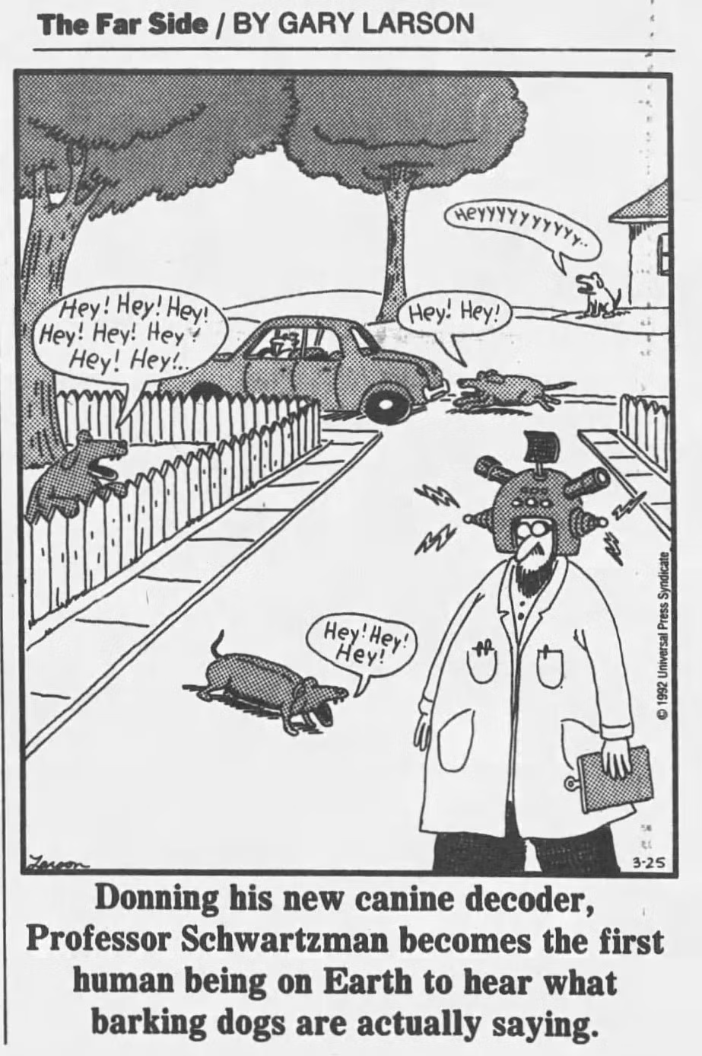
Model Adequacy
Sometimes the best model is not the best model

Slide 31
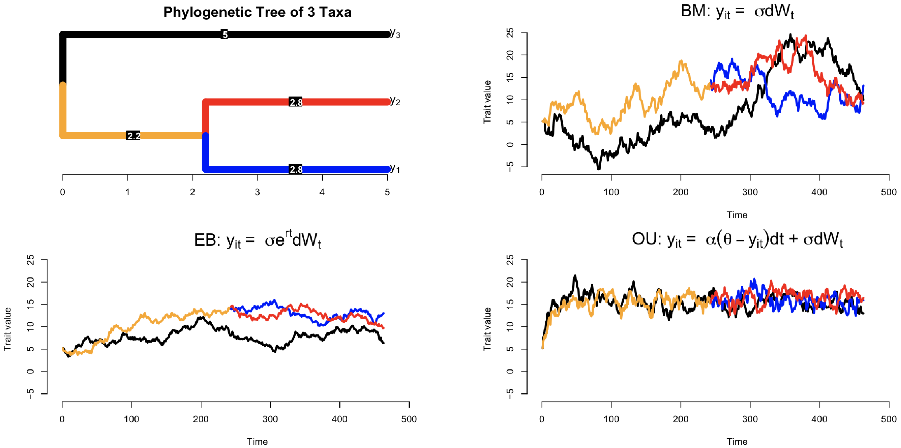
Simulations might help us understand our data

Slide 32
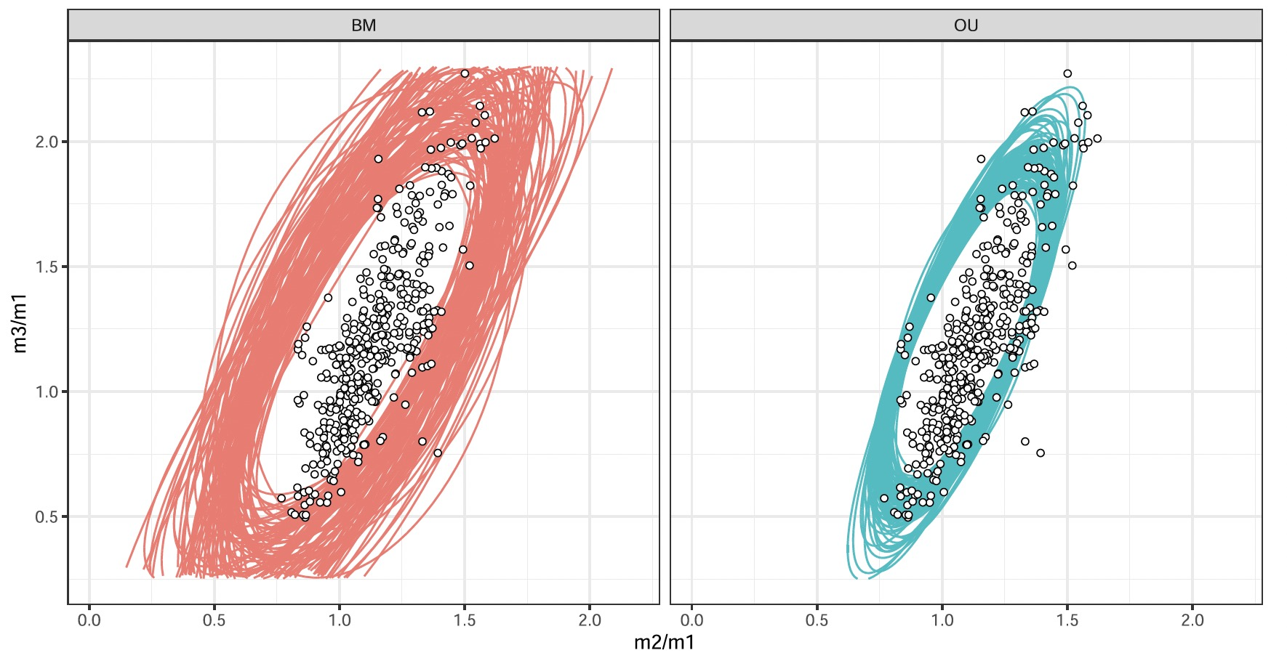
Bad models will generate data that does not match empirical observations

Slide 33
interpretation
Models
inadequacy
“Estimated data”
(phylogenies)
error/
inadequacy
error
Data
It's possible for the best model is not the best

Slide 34
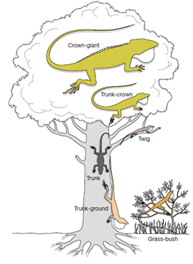
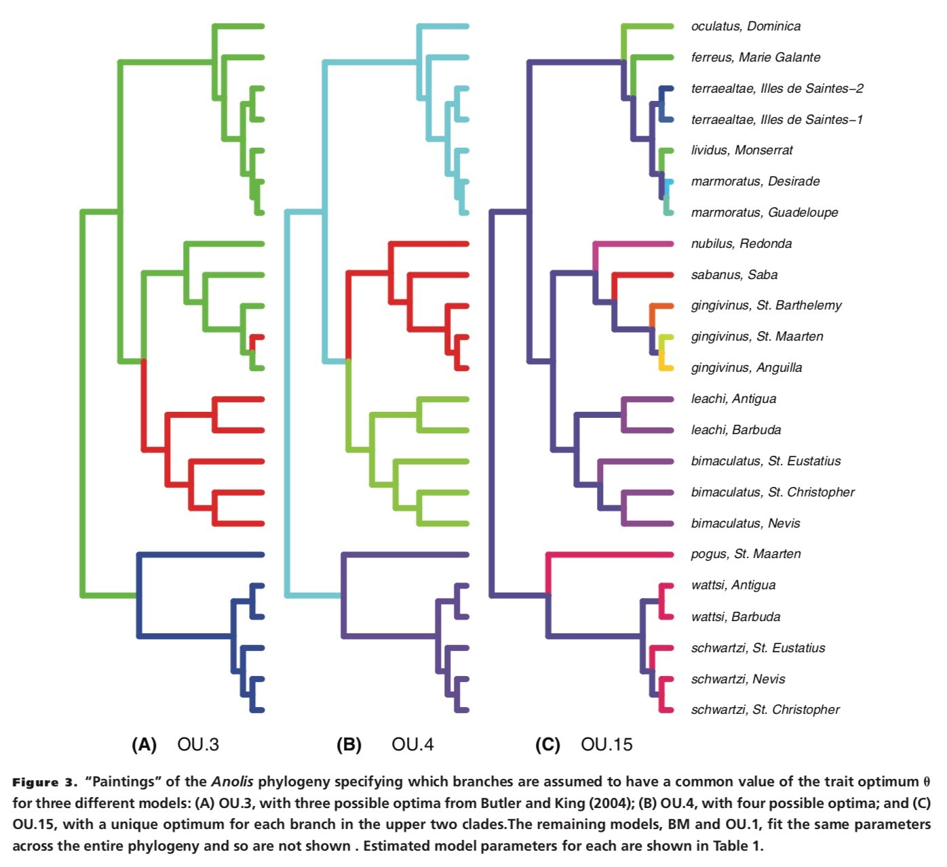
Adaptive radiation of Anoles
z
“Best models” (<2 loglik of best)
How different are they?
Boettiger, Coop, & Ralph 2012

Slide 35
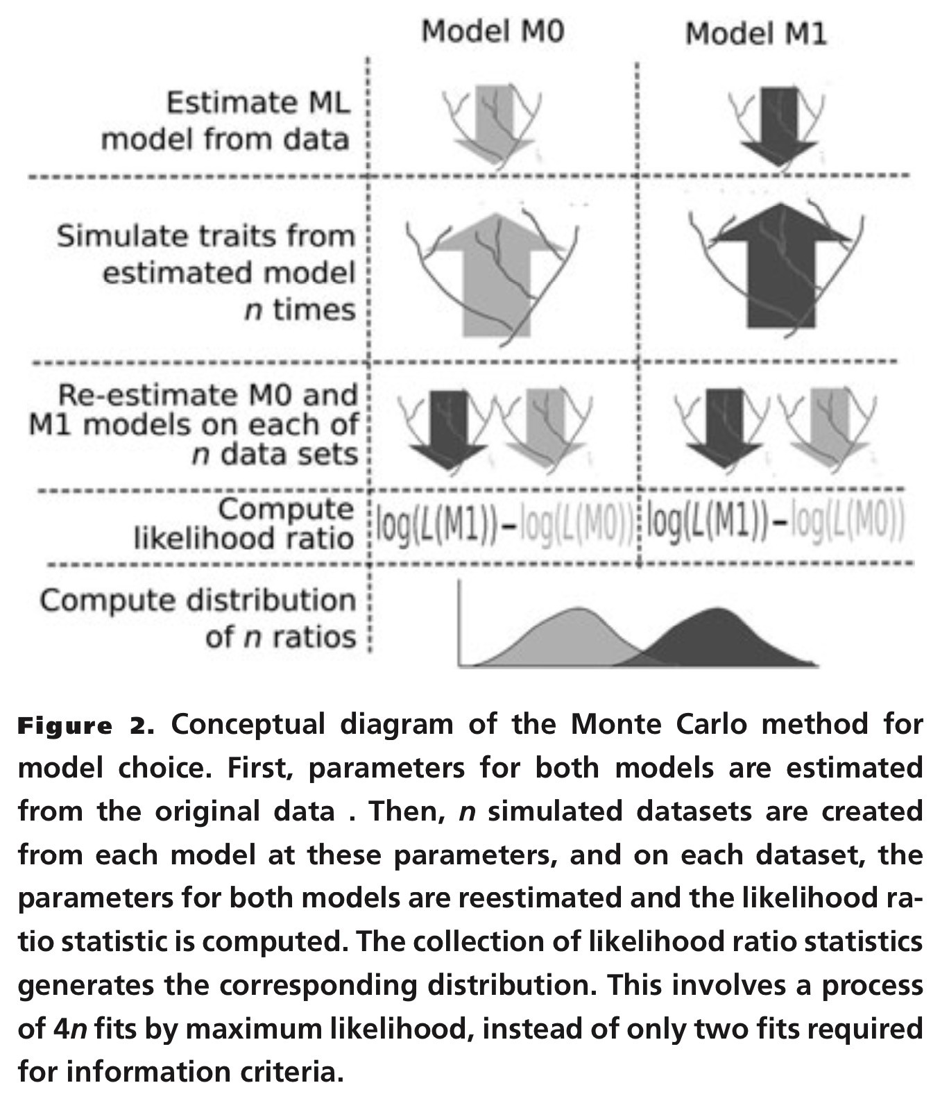
Boettiger, Coop, & Ralph 2012

Slide 36
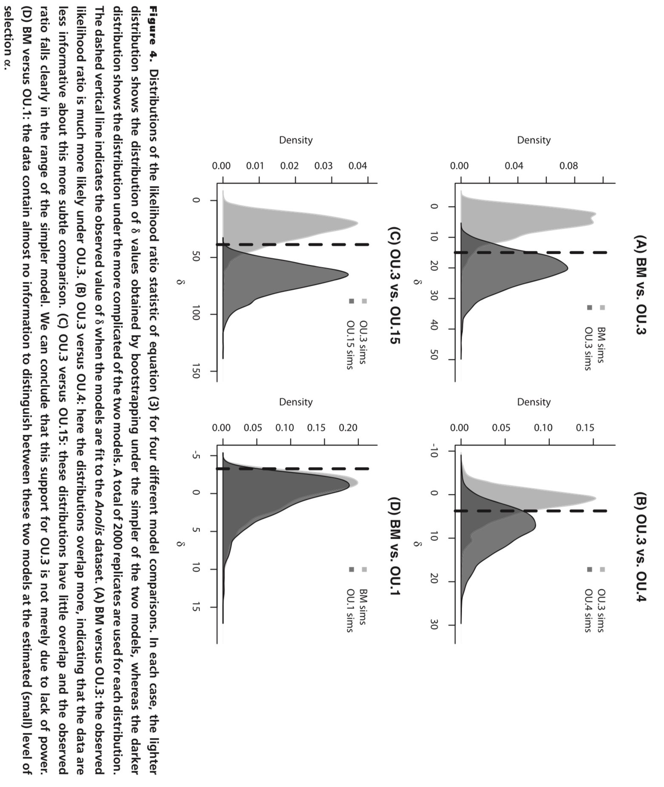
Boettiger, Coop, & Ralph 2012

Slide 37
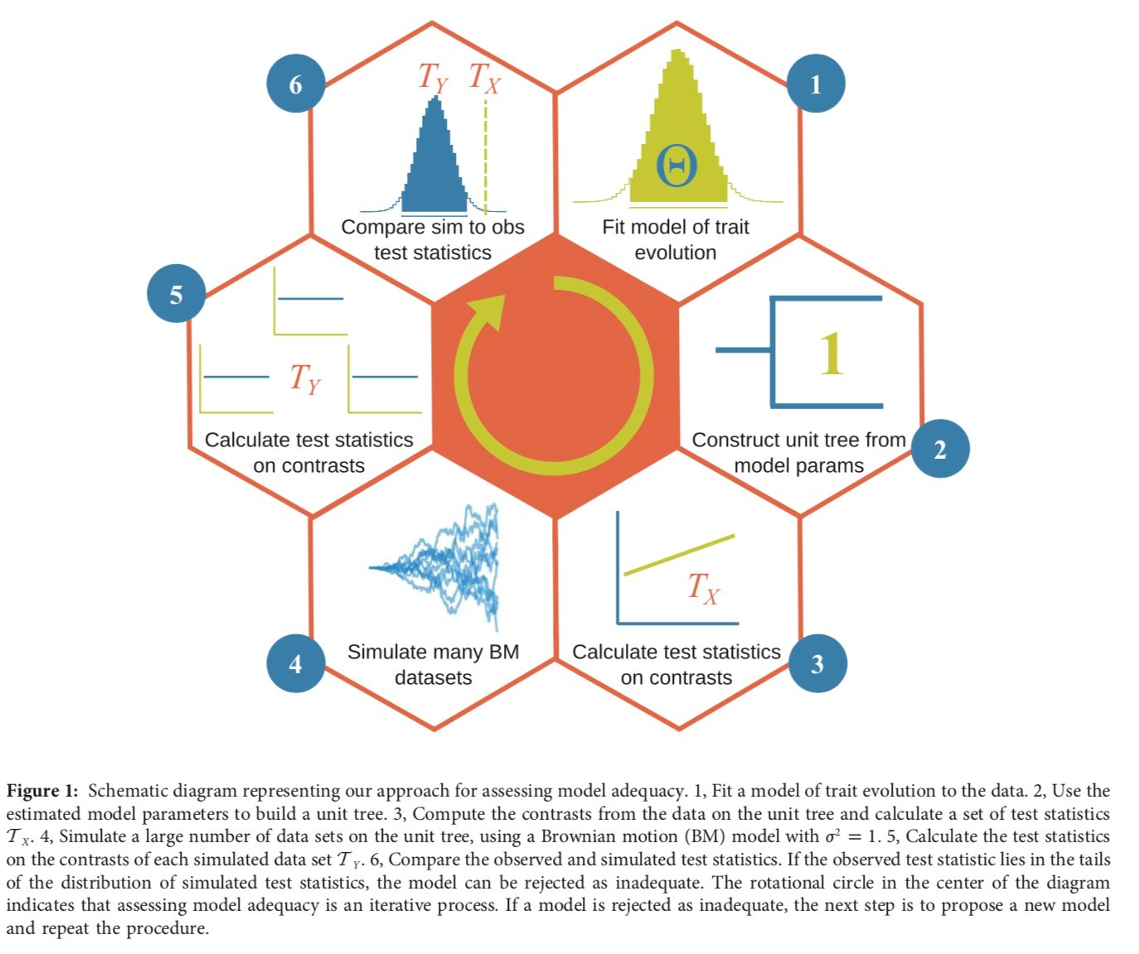
Pennell, FitzJohn, Cornwell, Harmon 2015

Slide 38
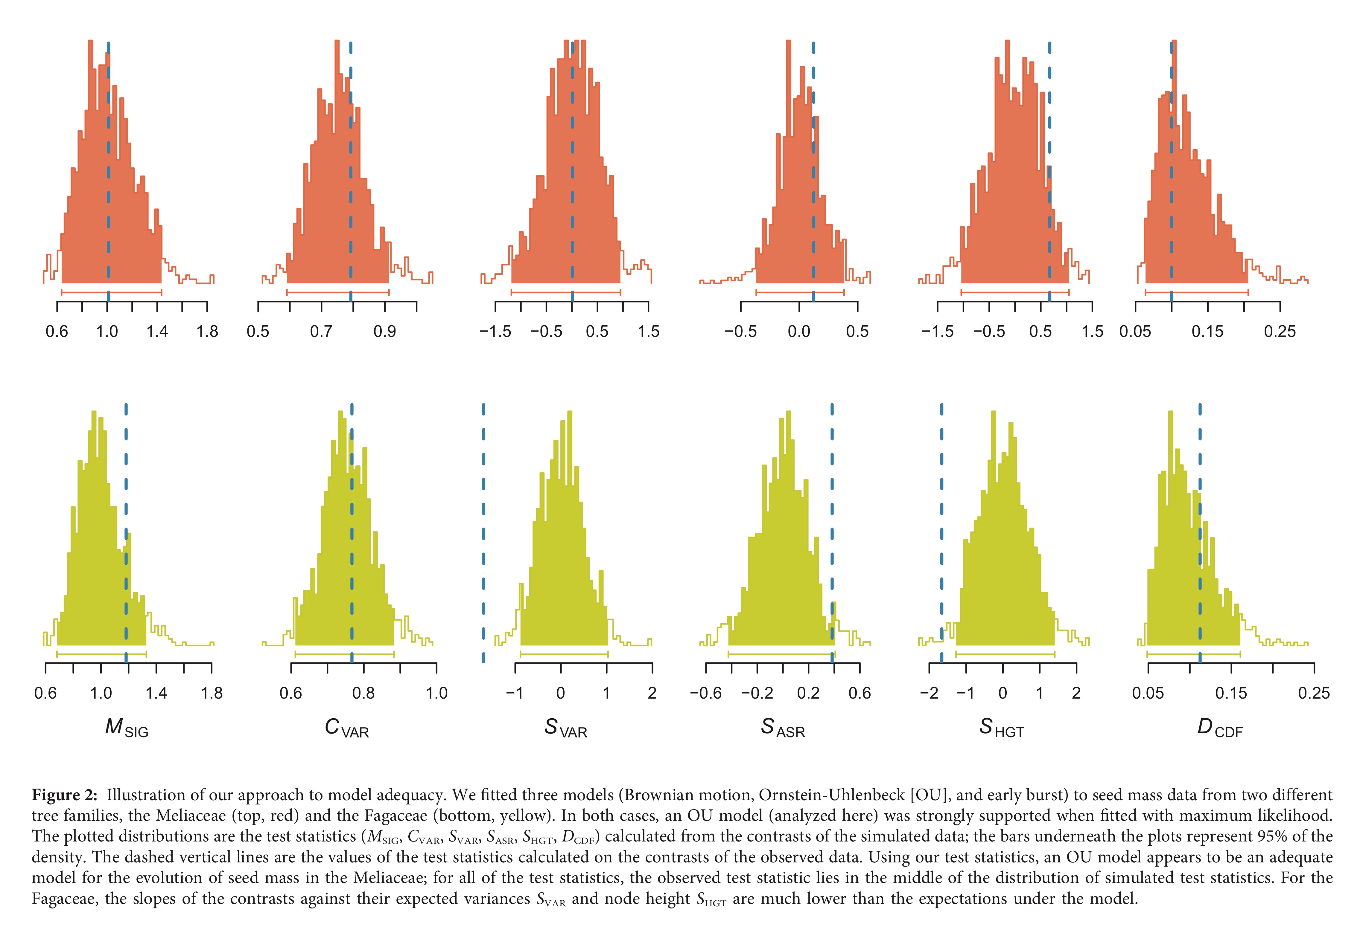
Pennell, FitzJohn, Cornwell, Harmon 2015

Slide 39
Lessons
Always account for measurement error
Always account for phylogenetic uncertainty
Always account for parameter estimation error
Always account for model inadequacy

Slide 40
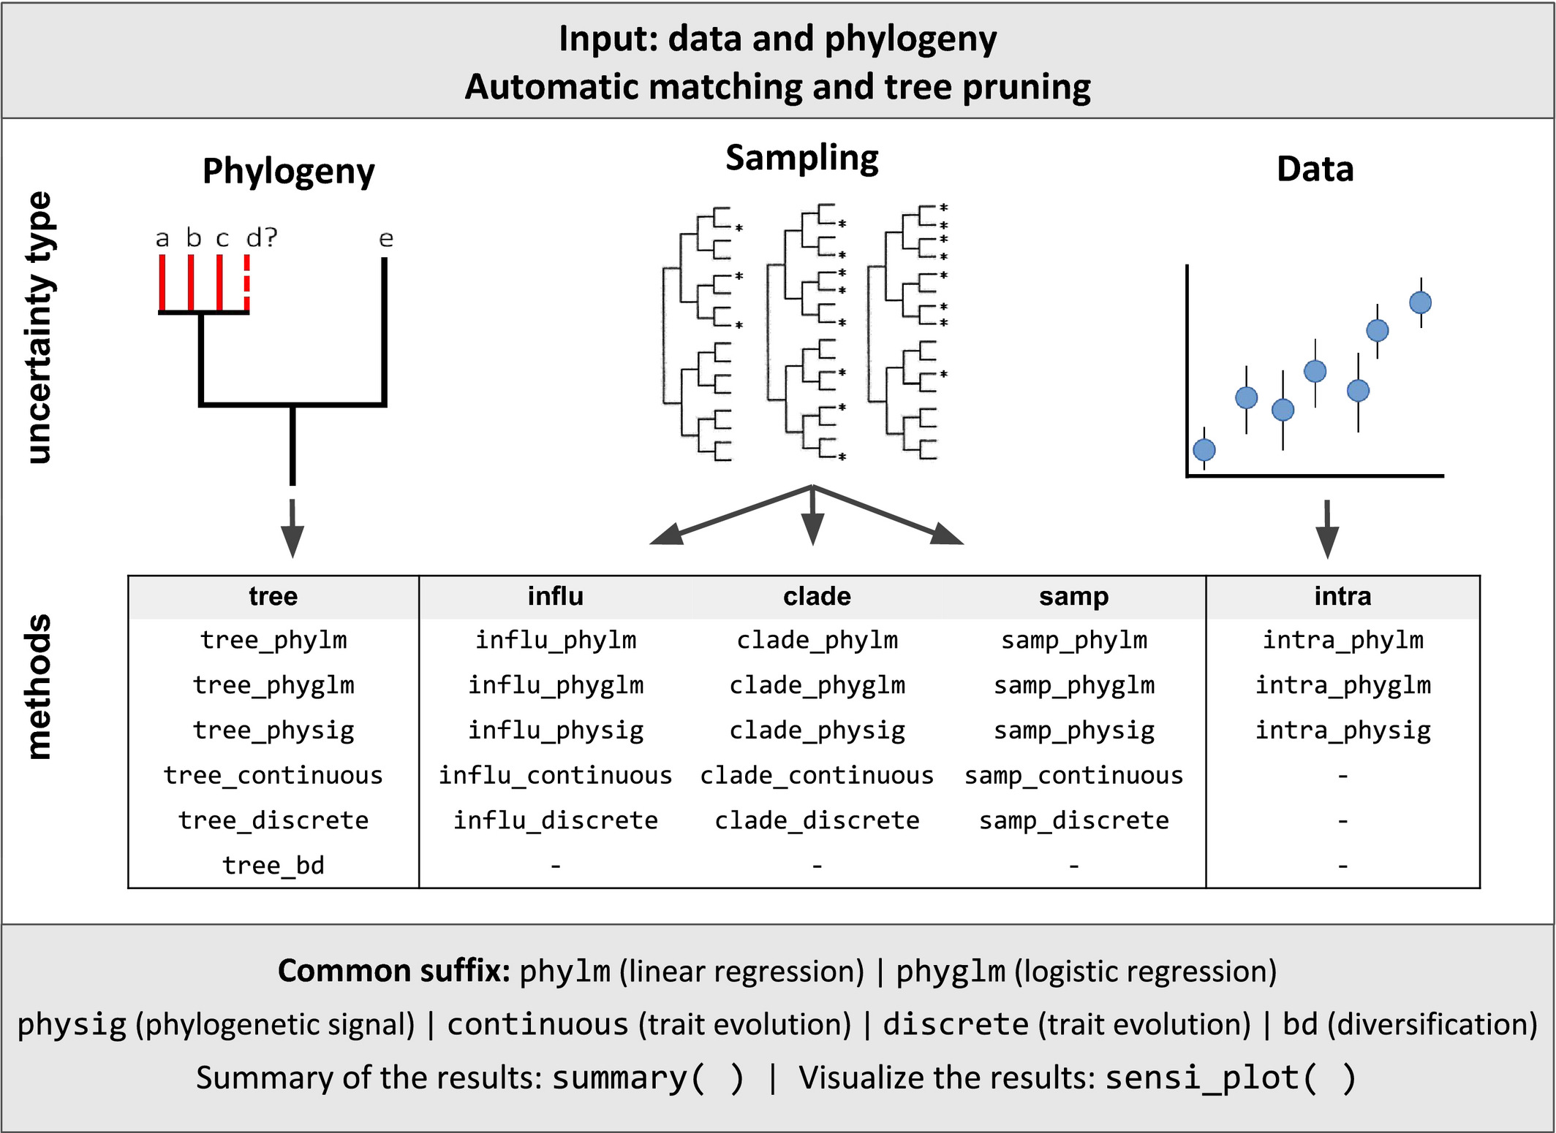
Sensitivity Analysis
Patermo, Penone, Wener, 2018

Slide 41
Identifiability issues
Sometimes model parameters interact with each other

Slide 42
Parameter estimation is an optimization procedure on a likelihood surface

Slide 43
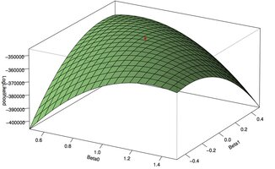
Sometimes likelihood surfaces can be flatter

Slide 44
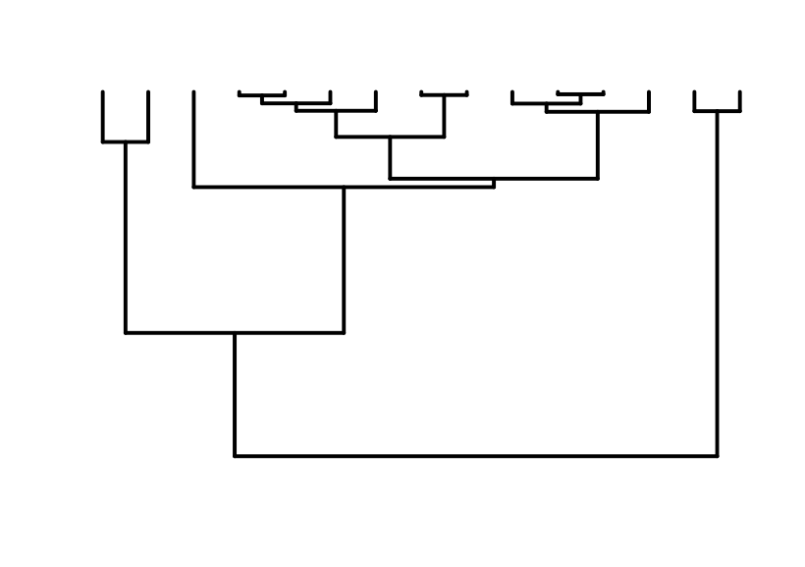
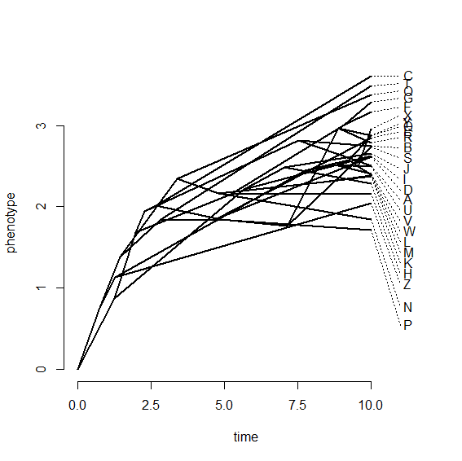
OU: optimum μ
Ancestral state y₀

Slide 45
This is what we want

Slide 46
This is what we get
Ho and Ané, 2014

Slide 47
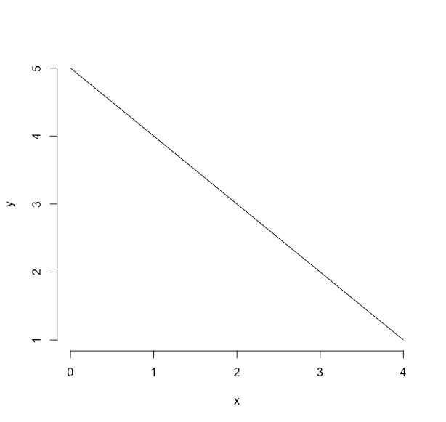
What is x in x+y=5

Slide 48
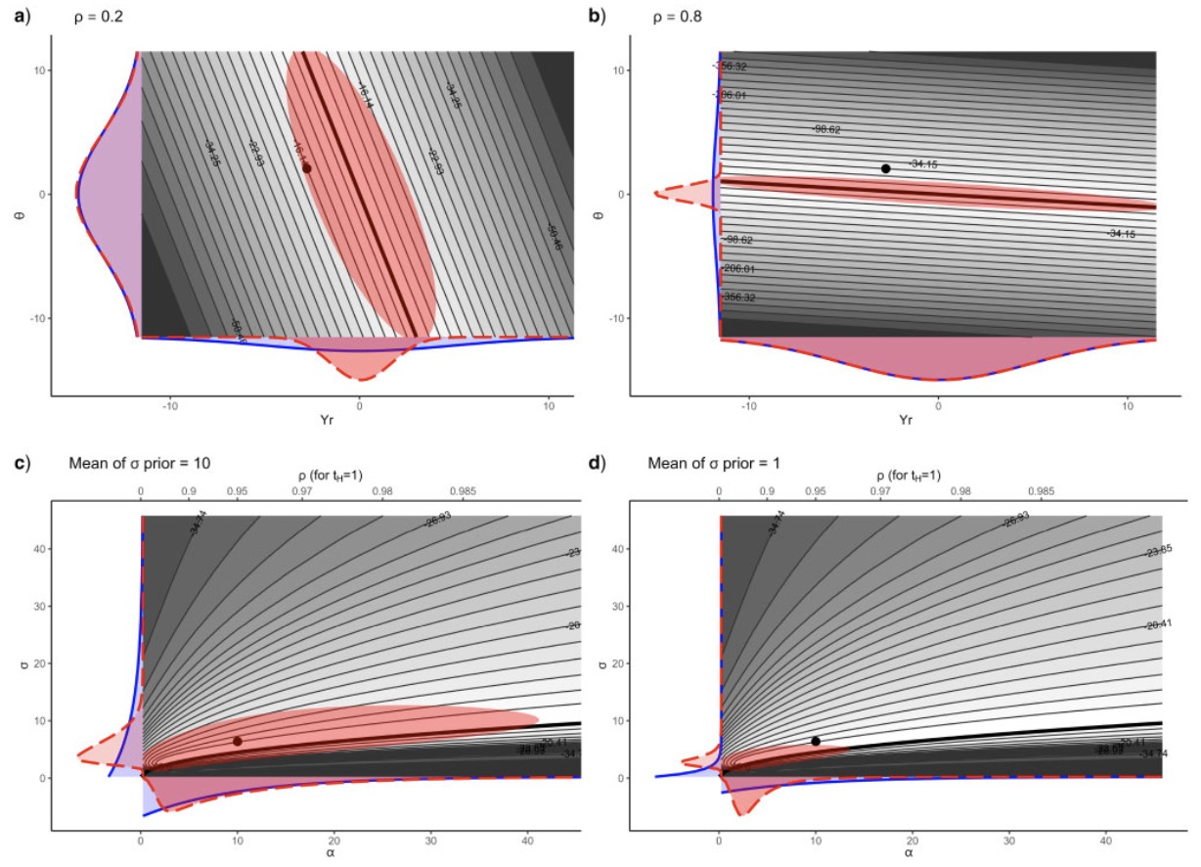
Cornuaut 2014

Slide 49
No information zone
What can we do?

Slide 50
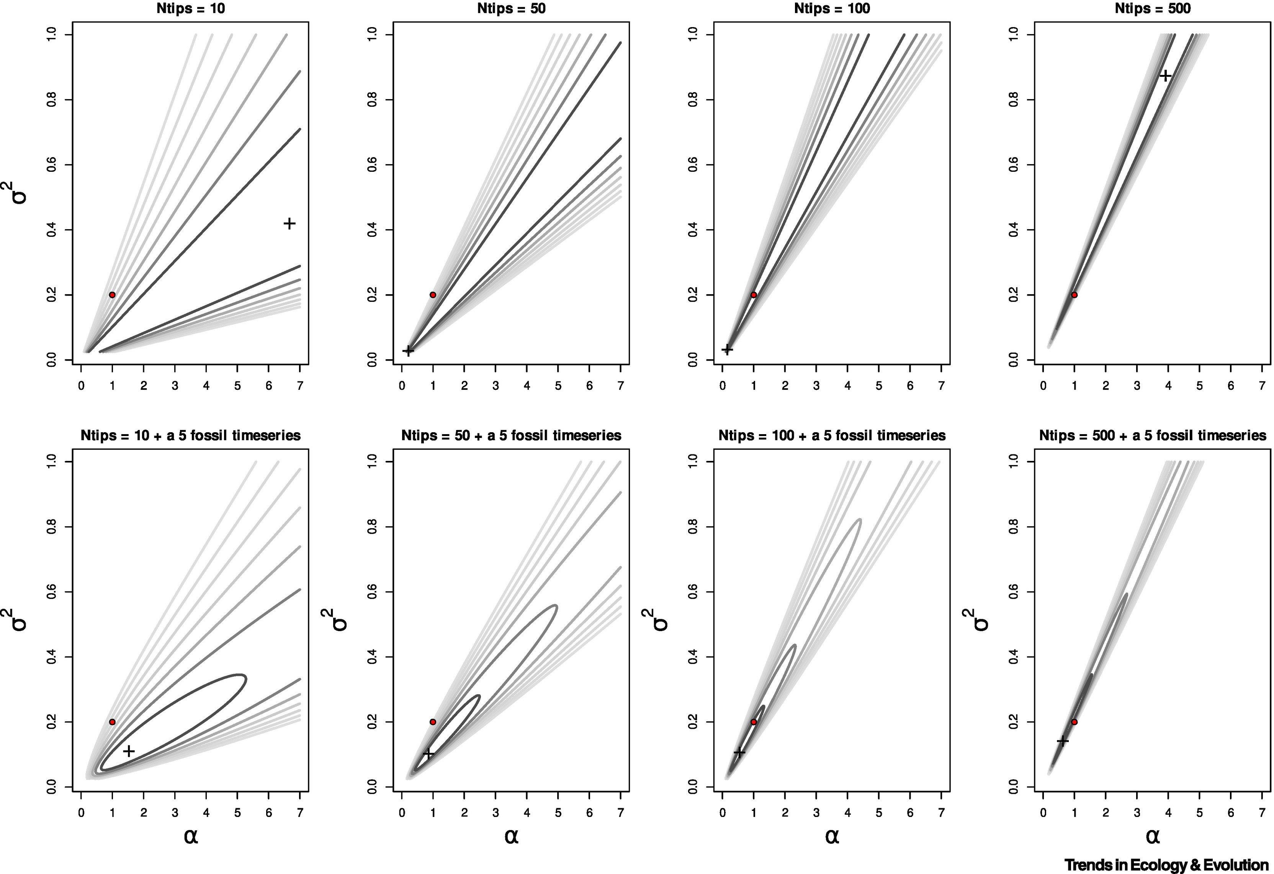
Add tips and fossils
Liow, Uyeda & Hunt, 2023

Slide 51
Lessons
Always account for measurement error
Always account for phylogenetic uncertainty
Always account for parameter estimation error
Always account for model inadequacy
Always account for identifiability issues

Slide 52
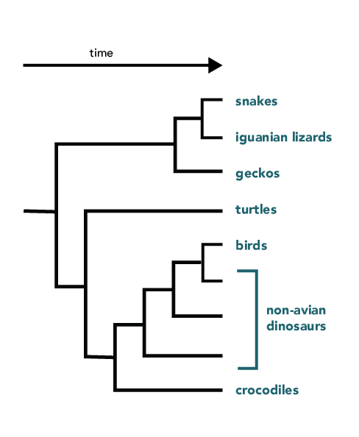
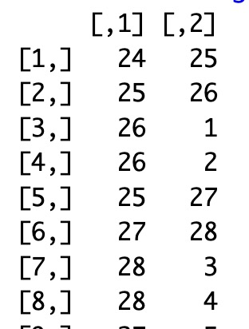
Phylogenetic trees
Graphical representation of phylogenetic relationships
Newick format: ((snakes,iguanas)geckos)
R
Nodes
What are the ideal traits of a tree?
Branches/edges

Slide 53
Phylogenetic trees
All desired species*
Fully resolved*
No short branches*
Uncertainty (topology and ages)

Slide 54
All desired species*
A
A
B
B
Prune tree and data
C
D
D
treeplyr
geiger
E
E
F

Slide 55
All desired species*
A
A
B
B
Adding tips
C
C
D
F
ape
phytools
D
E
F
E

Slide 56
All desired species*
A
A
B
B
switching tips
C
C
D
D
E
F
F
Known sister

Slide 57
Fully resolved*
No short branches*
A
A
B
B
Solving nodes
C
C
D
D
ape
Z
Z
E
Y
E
Z C
Z D
Z E
Z C
Z Y
Y D
Y E

Slide 58
Fully resolved*
No short branches*
A
A
B
B
Solving nodes
C
C
D
D
ape
Z
Z
E
Y
E
Z C
Z D
Z E
Z C
Z Y
Y D
Y E

